Slide 1
Heart attack: the reasons, asymptoms, what to do until the ambulance comes (first-aid)

Slide 2
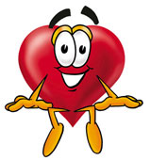
HEART ATTACK
Signs & Symptoms
Statistics
Coronary heart disease is the No. 1 cause of death in Serbia. Stroke is the No. 3 cause of death and a leading cause of serious disability. That's why it's so important to reduce your risk factors, know the warning signs, and know how to respond quickly and properly if warning signs occur.

Slide 3
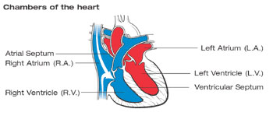
The Normal Heart
The normal heart is a pump made of muscle tissue. It's about the size of your fist.
The heart has four chambers. The two upper ones are the atria, and the lower two are the ventricles. (See diagram.) Four heart valves open and close to keep the blood flowing in one direction as it's pumped through the heart. Each valve has a set of "flaps" (also called leaflets or cusps).

Slide 4
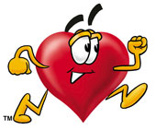
How It Works?
Dark bluish (oxygen-poor) blood returns to the heart after circulating through the body.
Enters the right atrium.
Then goes into the right ventricle.
The right ventricle pumps blood under low pressure into the pulmonary artery.
From there the blood goes to the lungs, where it gets fresh oxygen. Oxygen-rich blood is bright red.
Now goes to the left atrium.
Then enters the left ventricle
Then into the aorta which takes the blood from the heart to the rest of the body.
The cycle repeats as the blood flows back to the right atrium.

Slide 5
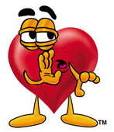
What is a Heart Attack? Also known as Myocardial Infarction
Death of or damage to part of the heart muscle due to an insufficient blood supply. Heart attacks occur when one of the coronary arteries that supply blood to the heart muscle is blocked. Blockage is usually caused from a buildup of plaque (deposits of fat-like substances) due to atherosclerosis. If a plaque deposit tears or ruptures, a blood clot may form and block the artery, causing a heart attack.

Slide 6
Heart Attack Warning Signs
Some heart attacks are sudden and intense. But most heart attacks start slowly, with mild pain or discomfort. Often people affected aren't sure what's wrong and wait too long before getting help. Here are signs that can mean a heart attack is happening:
Chest discomfort. Most heart attacks involve discomfort in the center of the chest, it can feel like uncomfortable pressure, squeezing, fullness or pain.
Discomfort in other areas of the upper body. Symptoms can include pain or discomfort in one or both arms, the back, neck, jaw or stomach.
Shortness of breath with or without chest discomfort.
Other signs may include breaking out in a cold sweat, nausea or lightheadedness
Minutes matter! Fast action can save lives — maybe your own.

Slide 7
What is a Stroke?
Stroke is a type of cardiovascular disease. It affects the arteries leading to and within the brain. A stroke occurs when a blood vessel that carries oxygen and nutrients to the brain is either blocked by a clot or bursts. When that happens, part of the brain cannot get the blood (and oxygen) it needs, so it starts to die.
What Are the Effects of Stroke?
The brain is an extremely complex organ that controls various body functions. If a stroke occurs and blood flow can't reach the region that controls a particular body function, that part of the body won't work as it should.

Slide 8
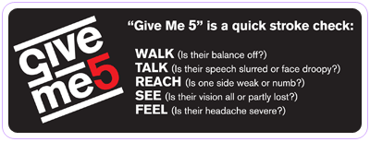
Learn To Recognize A Stroke
Stroke is a medical emergency. Know these warning signs of stroke and teach them to others. Every second counts:
Sudden numbness or weakness of the face, arm or leg, especially on one side of the body
Sudden confusion, trouble speaking or understanding
Sudden trouble seeing in one or both eyes
Sudden trouble walking, dizziness, loss of balance or coordination
Sudden, severe headache with no known cause
Call 9-1-1 immediately if you experience symptoms! Time lost is brain lost!

Slide 9
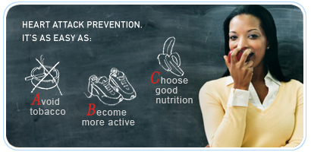
ABCs of Preventing
Heart Attack, Stroke and Heart Disease

Slide 10
Heart Attack
What Happens During a Heart Attack?
Heart Attack Symptoms
What Do I Do if I Have a Heart Attack?
How Is a Heart Attack Diagnosed?
What Is the Treatment for a Heart Attack?
How Are Future Heart Attacks Prevented?

Slide 11
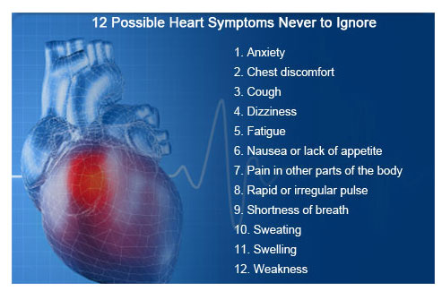

Slide 13
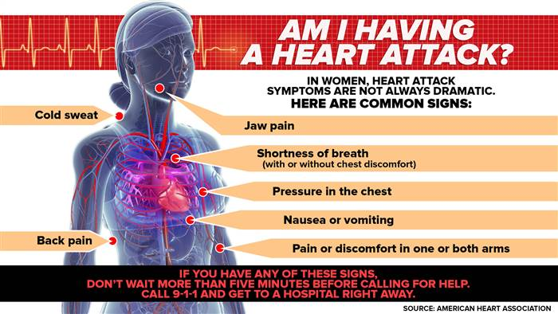

Slide 14
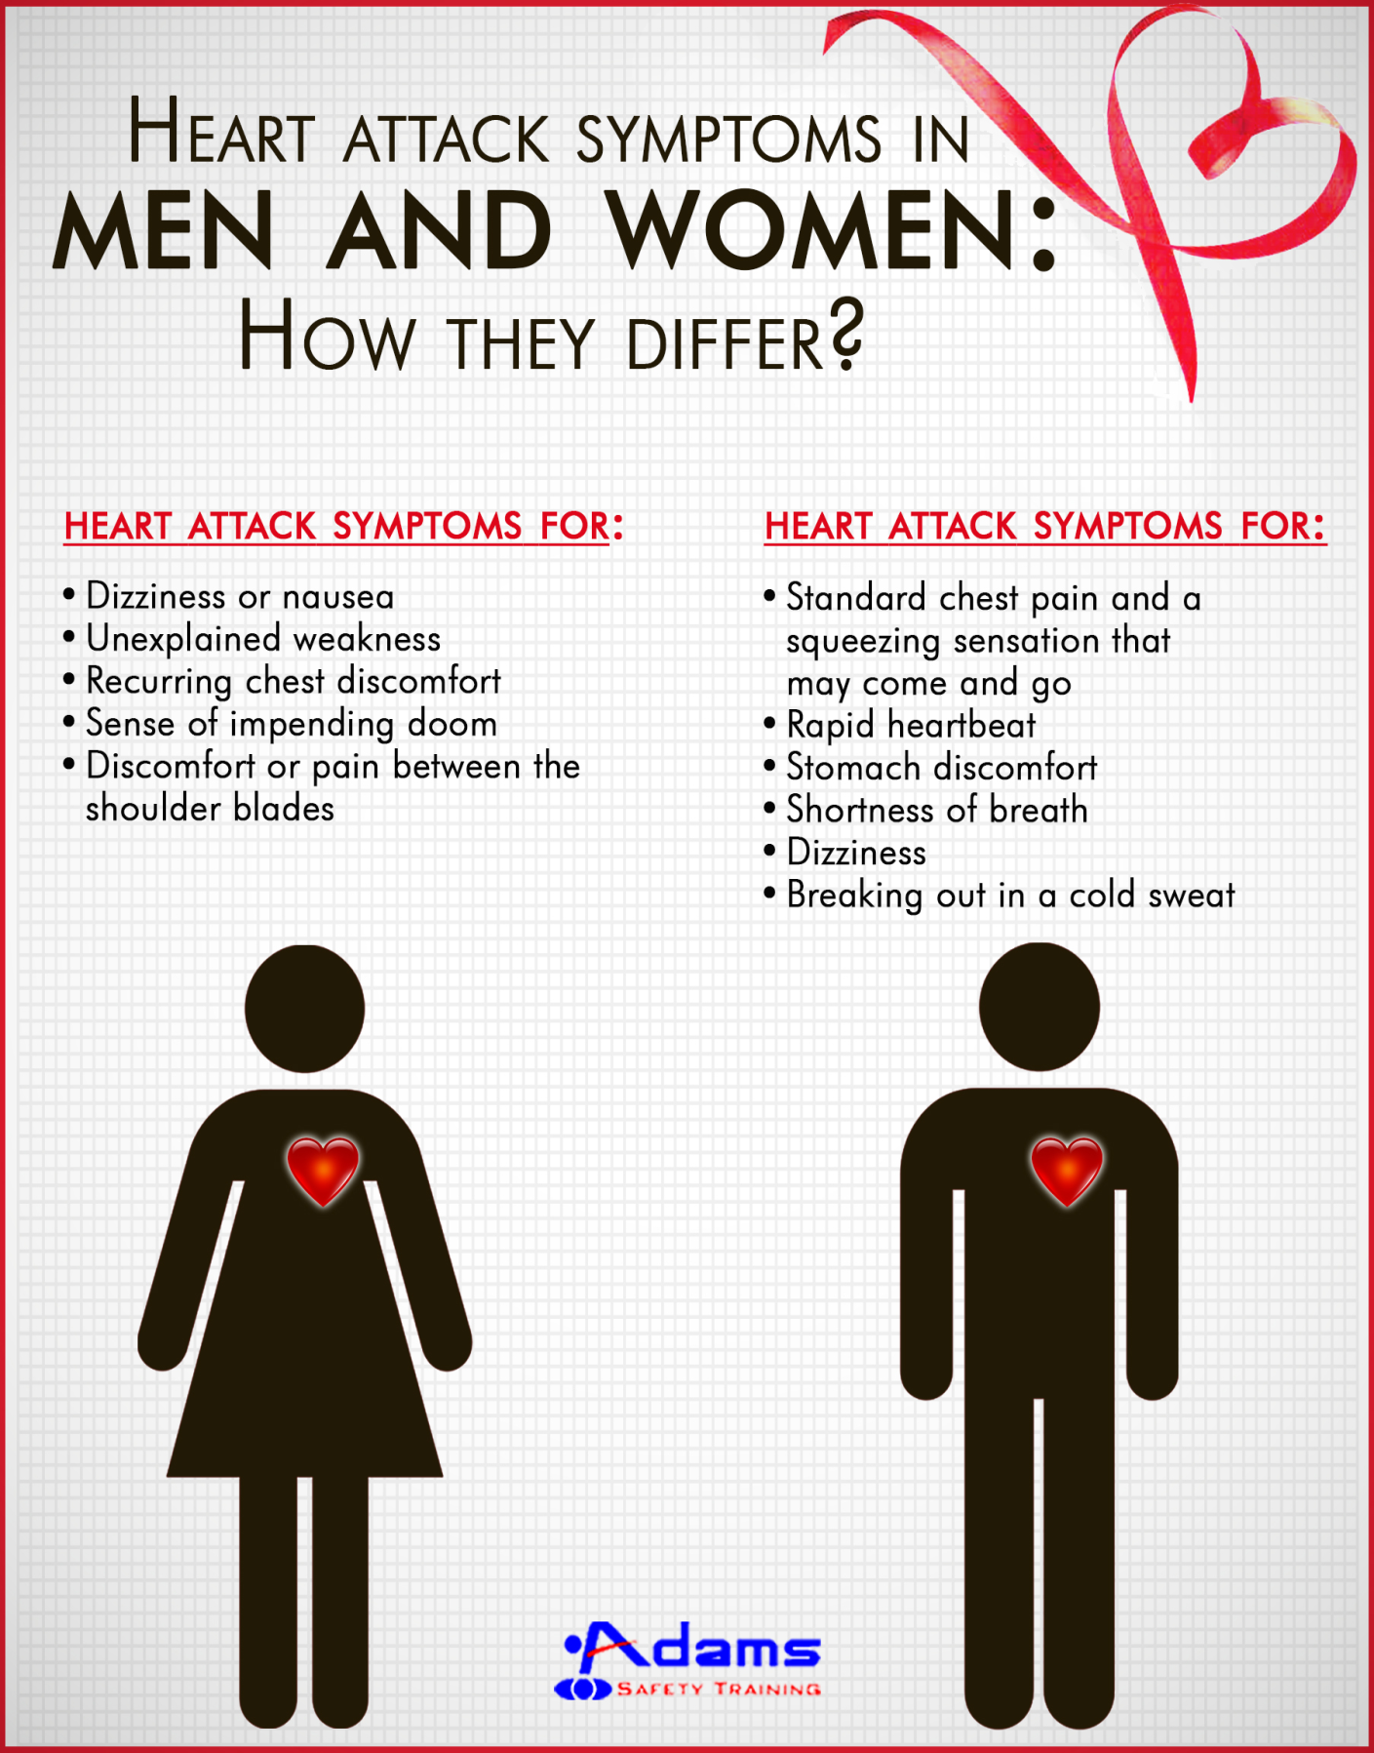

Slide 15
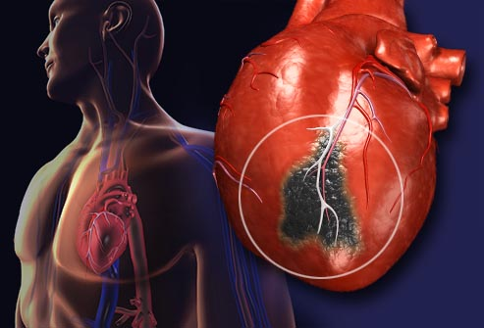

Slide 16
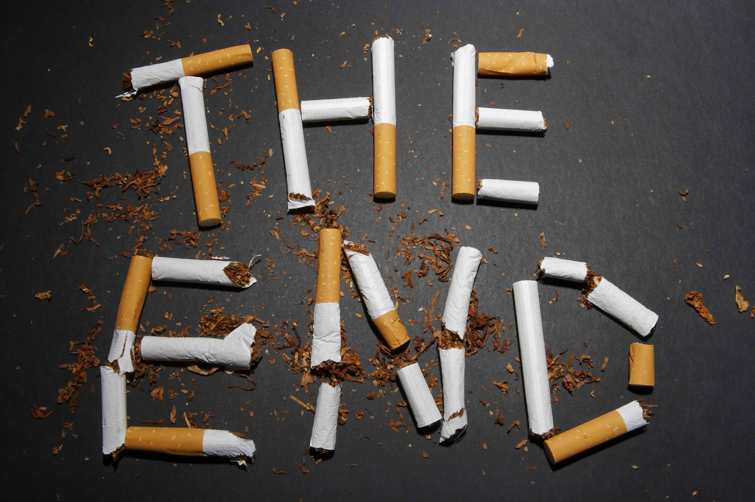
Leave your cigarettes!

Slide 17
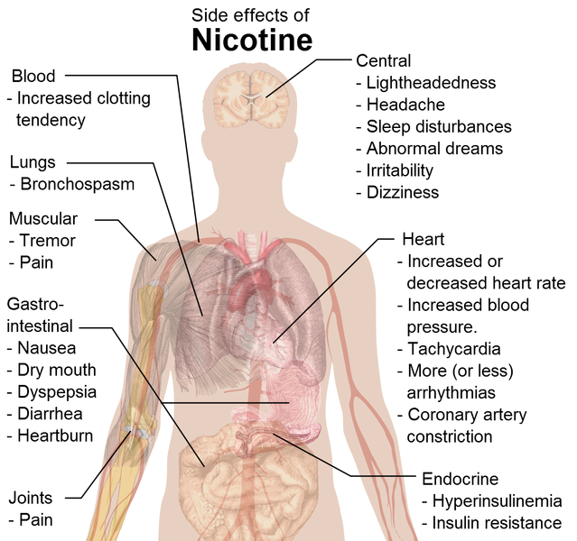
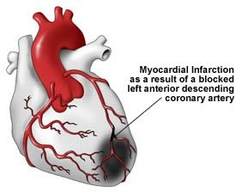
Studies have shown that a year after quitting smoking your risk of cardiovascular disease by as much as 50 per cent – enjoy smoking cigarettes increases blood clotting and increases the amount of fat in it

Slide 18
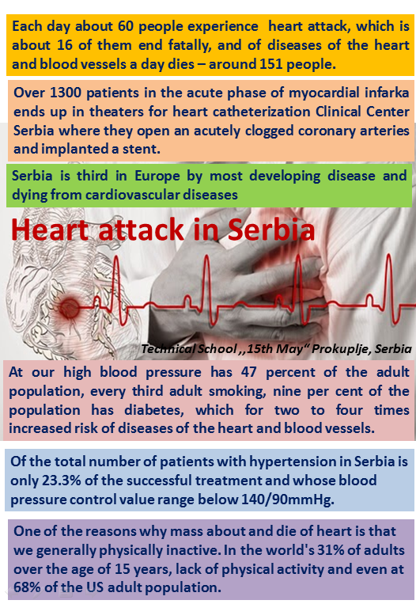
In our country...

Slide 19
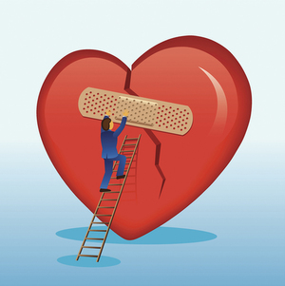
A lot of people after they experience acute myocardial infarction, later feels fear, which can be accompanied by depression or anxiety. This condition can be avoided if you laugh. Laugh as much as possible because this will raise the level of good cholesterol in the blood and destroy the hormones responsible for stress, which increases the risk of new heart attacks.

Slide 20
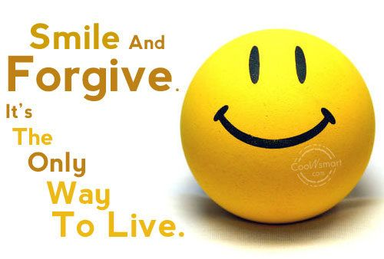

Slide 21
Technical School ,,15thMay“ Prokuplje, Serbia

