Slide 1
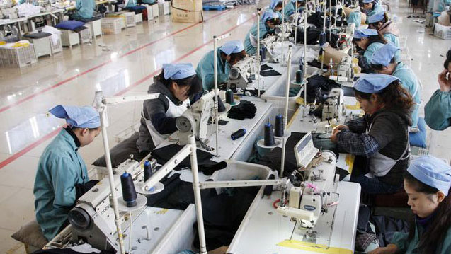
INDUSTRY 4.0 and the TEXTILE SECTOR

Slide 2
A NEW ERA IN THE PRODUCTION PROCESS AND THE PRODUCTS:
INDUSTRY 4.0

Slide 3
INDUSTRY 4.0
Industry 4.0 is the current trend of automation and data exchange in manufacturing technologies. It includes cyber-physical systems, the Internet of things and cloud computing
Industry 4.0 creates what has been called a "smart factory". Within the modular structured smart factories, cyber-physical systems monitor physical processes, create a virtual copy of the physical world and make decentralized decisions. Over the Internet of Things, cyber-physical systems communicate and cooperate with each other and with humans in real time, and via the Internet of Services, both internal and cross-organizational services are offered and used by participants of the value chain.

Slide 4
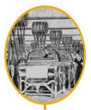
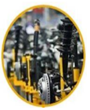
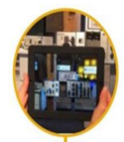
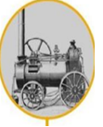
dfgdfhghh

Slide 5
What’s the effect of this development to the sector?
The capital needed in the sector has decreased
To become rich or to go bankrupt has been easier.
Personal abilities and imagination has become more important.
There’s no space for the unqualified.

Slide 6
The Trends Related to the Textile Sector in the Industry 4.0 Period
Smarter, Carriable, That Can be Personalized and can be connected to
ICT (Information & Communication Technologies)
Smart watch, smart eye-glasses, etc.
Clothes that can make connection via voice or signals from human brain.
e-Health
Clothes that can calculate and record vital signs and contact the nearest hospital in case of emergency
Defence Industry
Clothes adoptable to the environmental circumstances
Surfaces that can produce and save energy

Slide 7
Sports Equipments
Clothes that can calculate, record and increase performance
Home Technologies
Homes that have the features of early warning
(floor materials, home textile materials)
Consumer-friendly Products
Conformist products that can cormform with changeable desires of consumers

Slide 8
In 2025, 10% of the world’s population is going to use technologies that can be connected to the internet and that is wearable.
Classic Textile:
The circulation of yarn-fabric-clothes
From agriculture and chemistry to textile
Wearable Electronics:
Electronic materials that can be entegrated to clothes
From electronics and textile to confection
 e-Textile:
Textile, electronics & nanotechnology work together
Organic productive fibers & solar energy cells

Slide 9
Wearable Technology Market of the USA
(Billion Dollars)
Global Smart Textile Demand (Billion Dollars)

Slide 10
Some of the Expected Changes in the Textile Sector
Fabrics in which sensors can be placed.
Some changes in the breathing technology.
Fabrics that are conformist to the medical technologies
More frequent use of 3D printers.

Slide 11
How much Turkish textile sector is ready for the Industry 4.0?

Slide 12
Is Textile in Turkey compatitive enough for the 4.0 period?
Title | Summary of the Current Situation | Evaluation of the Situation
Capability | According to the technology literacy index, Turkey is the 48th among 148 countries. According to the same index, Turkey is the 80th in regard with the capability, 42nd according to the global innovation index.
Competitiveness | As far as the competitiveness is concerned, Turkey is the 39th among the 89 sectors in technical textile field whereas China is the 55th
Entrepreneurship | According to the World Bank Global Entrepreneurship Index of 2016,Turkey is the 28th among 133 countries in the world and it is the 18th among the 41 countries in its region.
High Average Low

Slide 13
The Top 10 Countries that Turkey Exports Textile to & Their Shares in the Market
POLAND
FRANCE
HOLAND
OTHER COUNTRIES
SPAIN
ENGLAND
IRAN
USA
BULGARIA
GERMANY
ITALY

Slide 14
TEXTILE AND ITS RAW MATERIALS EXPORTATION OF TURKEY
ANNUAL
Unit: USD
ANNUAL
CHANGE
%
ANNUAL
CHANGE
%
YEARS
EXPORT
IMPORT

Slide 15
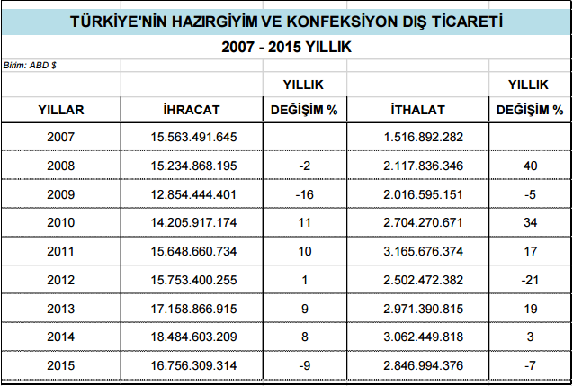
CONFECTION FOREIGN TRADE OF TURKEY.
ghjhhkkjlşlşlşlşyufgbdfsdfdfasasdassaasfddfdbfghfggghnghmhmhmnmnmnmnmnmdd
ANNUAL
Unit: USD
ANNUAL
CHANGE
%
ANNUAL
CHANGE
%
YEARS
EXPORT
IMPORT

Slide 16
Conclusion
The first country to apply the Industry 4.0 developments will be the leader of the textile market in the world. In order for Turkey to compete with other countries in this field, it must apply these applications before other countries do.
When we compare the annual textile exportation performance of Turkey, we see that it has been one of the leading countries with a great potential in the world textile market. The exportation made its peak in 2012 and 2013 and there seems to be a decrease in the export rates due to the economical crisis in the world, but experts are hopeful about the textile export performance of Turkey in the near future.

Slide 17
The Textile Exportation Performance of Turkey in 2 017
The total exportation of textile and raw materials of Turkey in January, 2017 was approximaley 763 billion dollars with 2.3 % increase.
When we compare our textile exportation values, it can be claimed that the most important country for our market is Germany. Our export value to Germany in January, 2017 was approximately 65 billion dollars.

